Slide 1
MACHINE LEARNING CONCEPT – 2 (CSE 3968)
SESSION: 2025–26
Handwritten Digit Recognition
Using Deep Learning, CNN & OCR for intelligent, real-time recognition of single-digit, multi-digit, and Roman numeral handwritten inputs.
Team Members:
Amulya Shrivastava (2341019456), Amaan Ahmed (2341001055), Anusha Kumari (2341011265), Kumari Muskan (2341013427)
Section: 23412F3
Semester: 6th
Branch: B.Tech CSE
Department of Computer Science & Engineering
ITER, Siksha 'O' Anusandhan (Deemed To Be University)
Bhubaneswar, Odisha

Slide 2
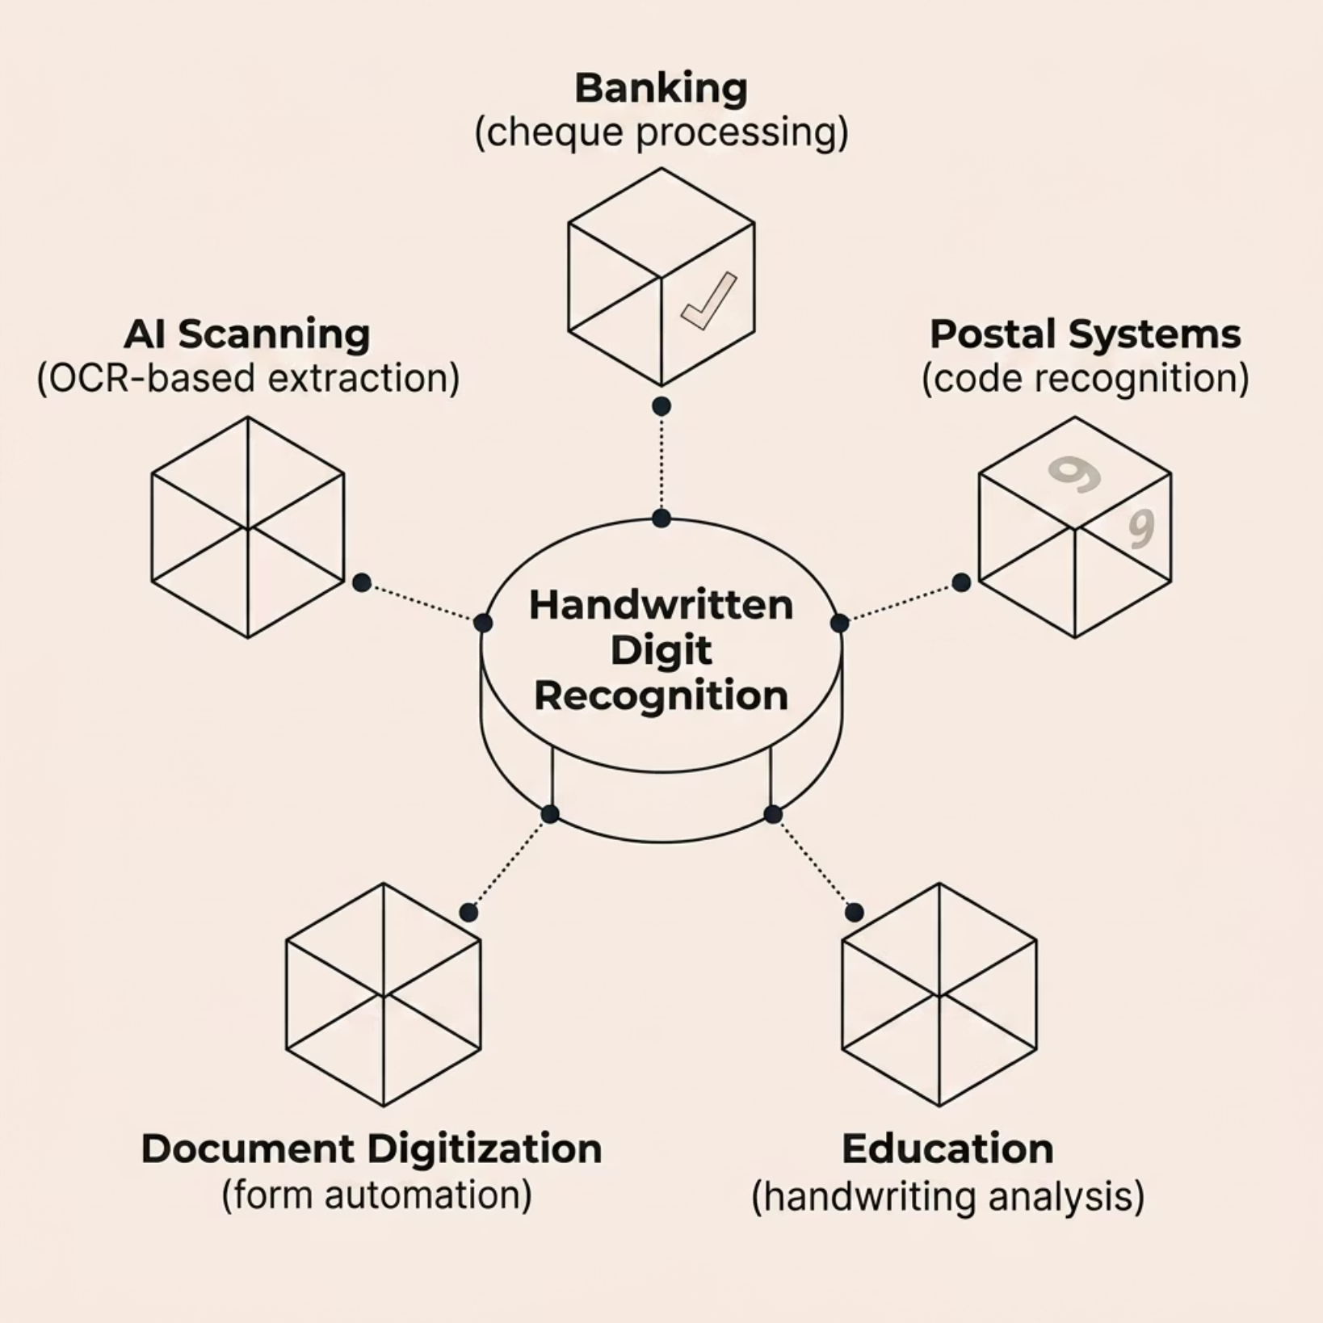


INTRODUCTION
What Is Handwritten Digit Recognition?
Handwritten Digit Recognition enables machines to identify handwritten numerical content from images — a core application of AI, Machine Learning, and Computer Vision. It powers automation across banking, postal systems, education, and document digitization.
Traditional systems struggle with unclear strokes, rotated images, multi-digit inputs, noisy backgrounds, and irregular spacing — reducing real-world accuracy.
This project integrates Deep Learning (CNN) + Tesseract OCR to overcome these limitations with improved flexibility and prediction accuracy.

Slide 3

PROBLEM & OBJECTIVES
Challenges & What We Set Out to Achieve
Key Challenges
Project Objectives
Multiple digits in a single image
Rotated, inverted, or poorly aligned inputs
Irregular spacing and overlapping structures
Roman numeral representations
Noisy, low-quality handwritten images
No adaptive learning from past mistakes
Recognize single and multi-digit handwritten inputs
Support Roman numeral identification
Integrate Tesseract OCR for improved extraction
Implement custom retraining from misclassified samples
Build a Flask web app for real-time predictions

Slide 4

METHODOLOGY
End-to-End Project Pipeline
Image Preprocessing
OCR & Segmentation
Grayscale, denoise, threshold, resize, rotate.
Tesseract scan and contour-based separation.
Data Collection
CNN & Deployment
MNIST, custom samples, and user uploads.
Train CNN, Flask app, real-time predictions.
The system follows a structured multi-stage workflow — from data collection and preprocessing through OCR integration, CNN-based prediction, and finally real-time web deployment — ensuring accurate and flexible handwritten digit recognition.

Slide 5
DATA & PREPROCESSING
Dataset & Image Preprocessing
Data Sources
Preprocessing Steps
01
MNIST Dataset
Grayscale — standardize
60,000 handwritten samples
02
Custom Datasets
Noise Removal — clean artifacts
Team-collected samples
03
Thresholding — binarize
User Uploads
04
Web interface samples
Resizing — 28×28
Retraining Pool
05
Misclassified samples for updates
Rotation — fix orientation
06
Contour Detection — isolate digits

Slide 6

OCR & SEGMENTATION
Tesseract OCR & Digit Segmentation
OCR Integration Workflow
Digit Segmentation
01
Contour Detection
Upload handwritten image
Trace ink regions to find digit boundaries and separate connected shapes.
Use the web interface or drag-and-drop.
02
Check angle and layout
Overlapping Digits
Auto-correct inverted, tilted, or rotated images.
Use boundary checks to distinguish adjacent or touching strokes.
03
Send to Tesseract OCR
Normalization
Scan and identify candidate characters.
Resize and center each crop for consistent CNN input.
04
CNN Integration
Segment digits
Pass normalized crops into the model one by one.
Contour detection isolates each digit.
05
Multi-Digit Output
Predict symbol values
Combine ordered predictions to reconstruct full numbers.
The CNN classifies each extracted digit or Roman numeral.
06
Robustness
Return results
Handles varied handwriting, spacing, and orientation.
Show predictions with confidence and annotations.
Segmentation and OCR work together to recognize multi-digit and Roman numeral inputs reliably.

Slide 7
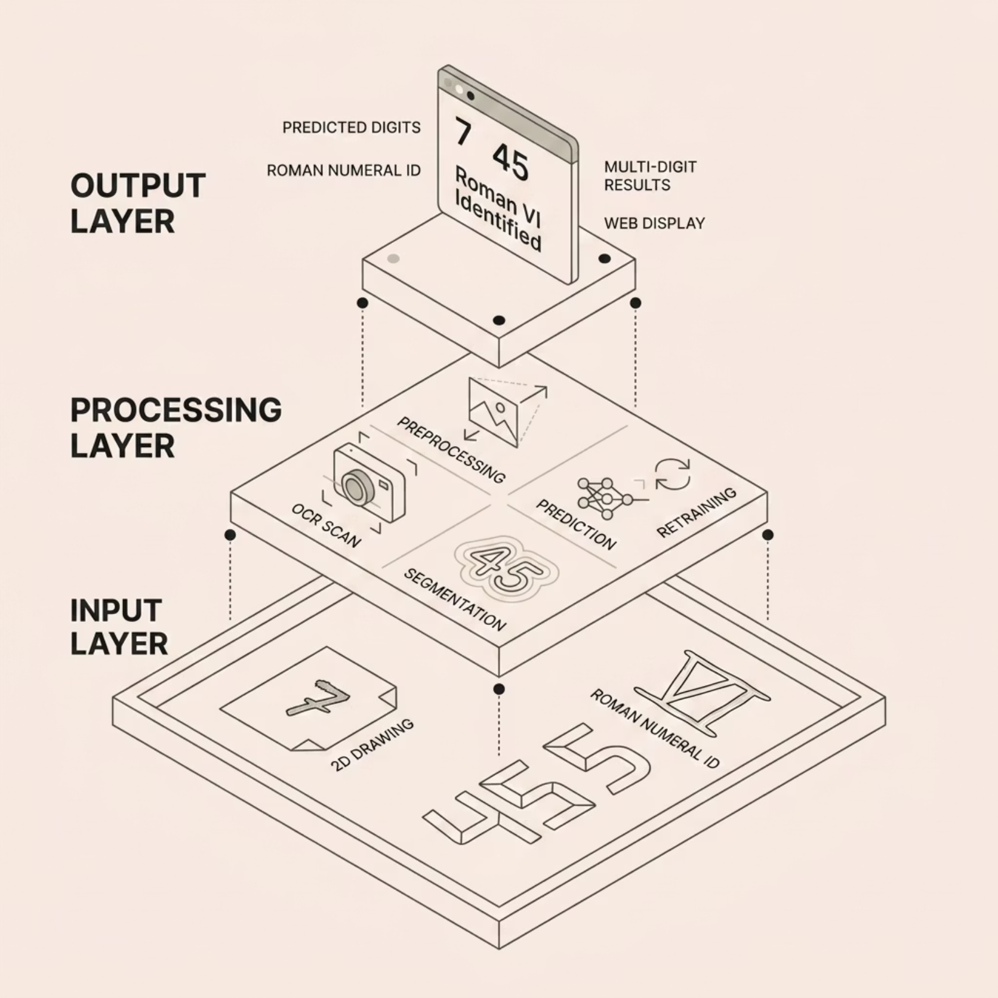

MODEL & ARCHITECTURE
CNN Model & System Architecture
CNN Architecture Workflow
01
System Architecture Layers
Image input (28×28)
02
Resize, normalize, and denoise
03
Convolution extracts features
04
ReLU adds non-linearity
05
Max pooling reduces dimensions
06
Flatten, dense layers, softmax output

Slide 8

IMPLEMENTATION & WEB APP
Technologies & Flask Web Application
Python
TensorFlow & Keras
OpenCV
Core language
Model training
Image preprocessing
Tesseract OCR
Flask
NumPy
Text extraction
Web app framework
Array operations
Flask Web Application
Web App Features
The browser app lets users upload handwritten images and receive instant predictions for single-digit, multi-digit, and Roman numeral inputs.
Image upload and drag-and-drop
Digit and Roman numeral prediction
Confidence scores
Batch image support
Prediction history
Retraining feedback
Execution Flow: Data Loading → Preprocessing → CNN Training → Real-Time Prediction → Result Display
Backend Infrastructure
The Flask backend handles preprocessing, inference, logging, and feedback storage. API endpoints support prediction and retraining while keeping the app responsive.

Slide 9
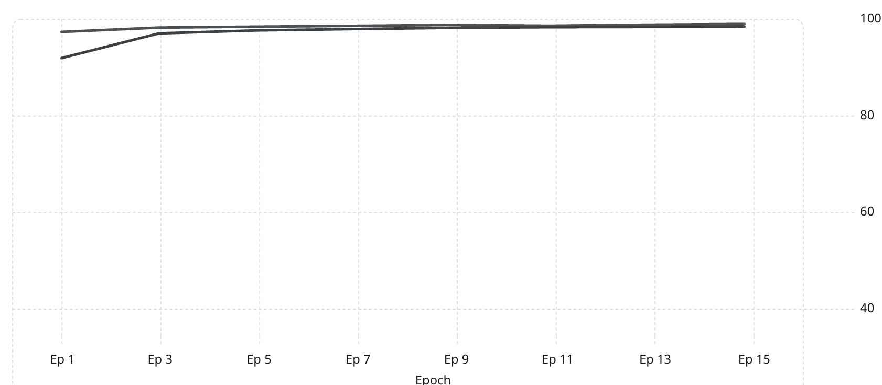
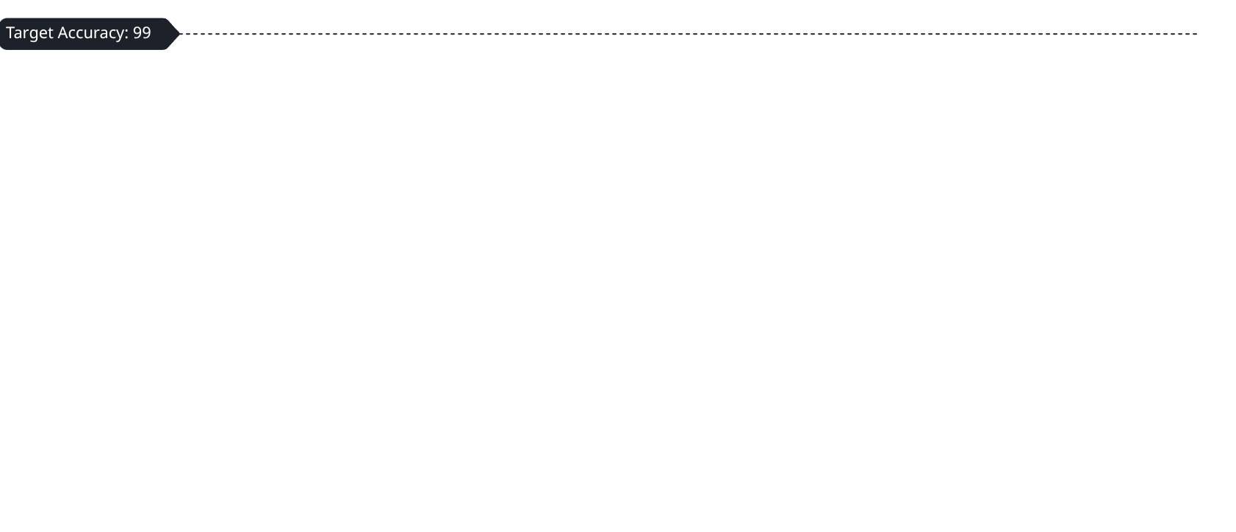
RESULTS & APPLICATIONS
Model Performance & Real-World Applications
Training Results (15 Epochs)
Key Applications
Validation Accuracy (%)
Training Accuracy (%)
Bank Cheque Recognition
Postal Code Systems
Smart Classrooms
AI Document Processing
Final validation accuracy reached 99.10% with val_loss of 0.0344.
Custom retraining improved performance by learning from misclassified samples.
Automated Form Digitization
OCR Intelligent Scanning

Slide 10
FUTURE SCOPE · CONCLUSION · TEAM
Looking Ahead & Project Summary
Future Enhancements
Conclusion
Successfully built an intelligent handwritten digit recognition system using CNN + Tesseract OCR, supporting single-digit, multi-digit, and Roman numeral inputs with 99.10% validation accuracy. The adaptive retraining mechanism and Flask web app demonstrate practical, real-world usability.
Cloud Deployment — remote accessibility & scalability
Mobile App — camera-based instant prediction
Real-Time Camera — live handwritten recognition
Alphabet Recognition — extend to full character sets
Team Contributions
Amulya — Architecture, CNN, OCR, Web App
Amaan — Retraining, Testing, Accuracy
Anusha — Segmentation, Contour Detection
Muskan — Optimization, Dataset Refinement
Multi-Language Support — regional & international scripts

